Slide 1
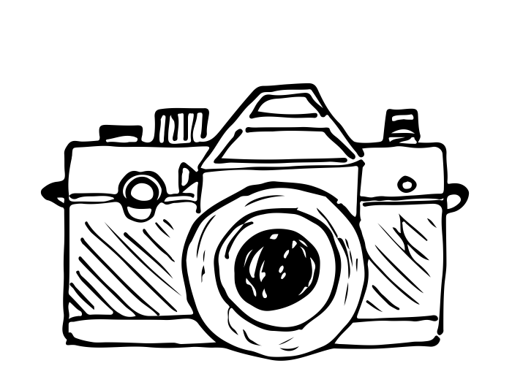
Photovoice is:
An innovative way to reflect, talk, learn, share, and make a difference for your community by using a camera to share your perspective and foster dialogue.
Steps may include:
Take photographs
Discuss photos & initial experience
Caption the images based on probe questions
Discuss changes that could be made to the environment

Slide 2
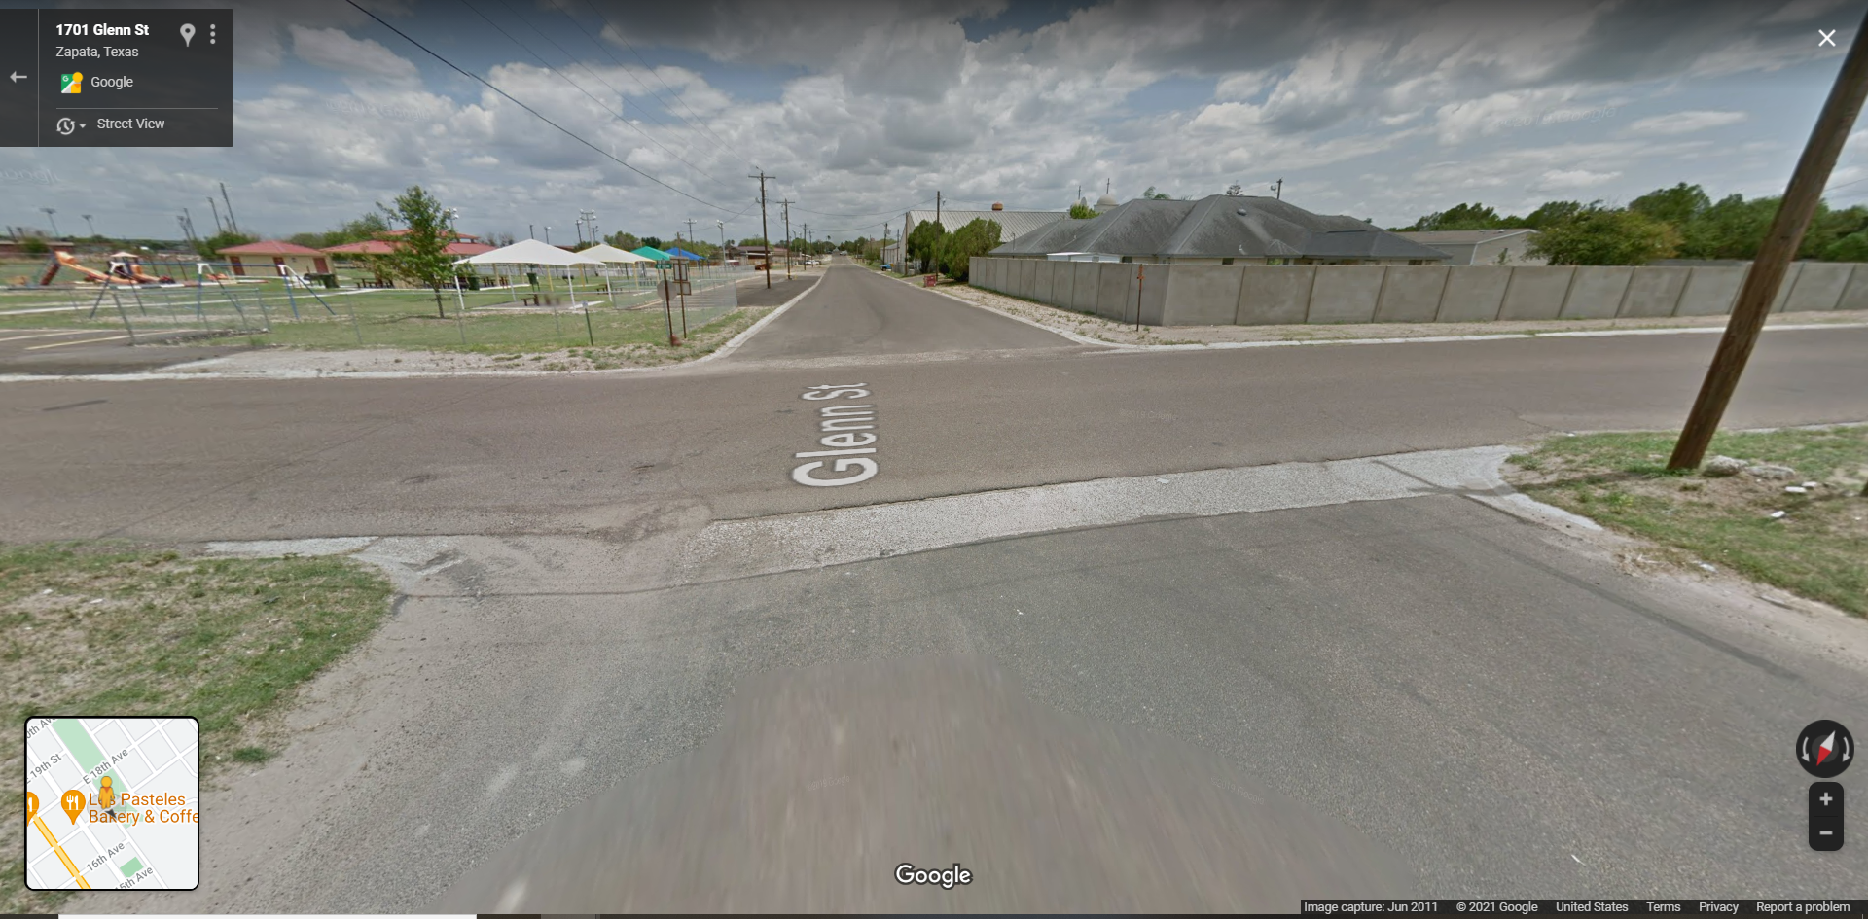
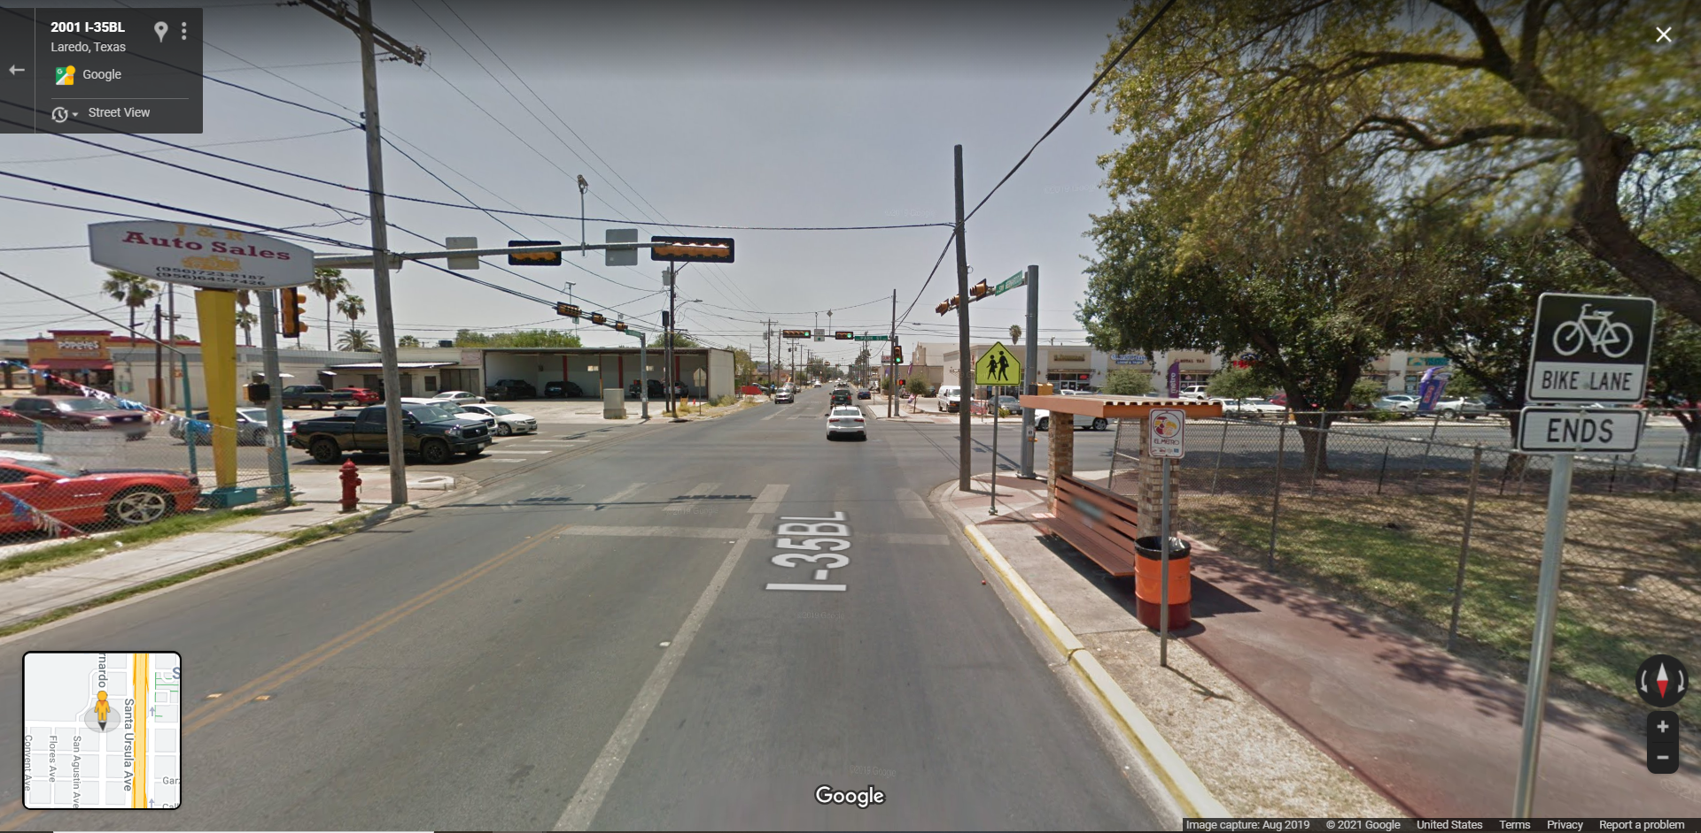
Photovoice Example with Questions:
Is it walkable / is it unwalkable? Explain:
What would you keep that supports your walking? Explain:
What hinders your ability to walk? What would you change? Explain:
When taking these photos, how did you get from place to place? Walk, bike, skate, car ride, etc.

