Slide 1
WoW-E Youth Session #2
Mapping Activity
June 9, 2021

Slide 2
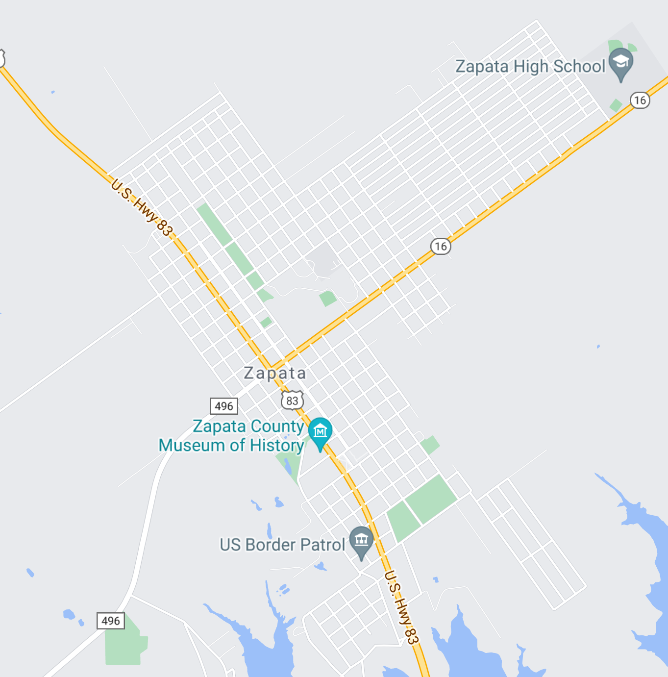
Zapata
Using the annotate function, put a stamp somewhere you can be physically active.

Slide 3
Zapata
Using the annotate function, put a stamp somewhere you can buy healthy food.

Slide 4
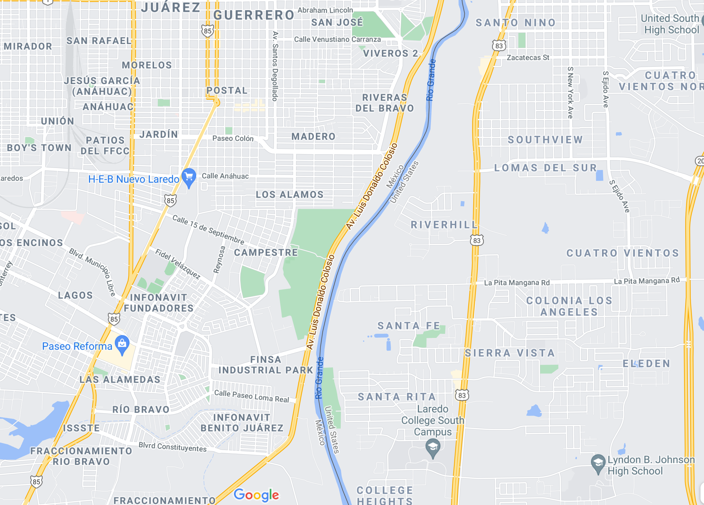
Laredo
Using the annotate function, put a stamp somewhere you can be physically active.

Slide 5
Laredo
Using the annotate function, put a stamp somewhere you can buy healthy food.

